Slide 1


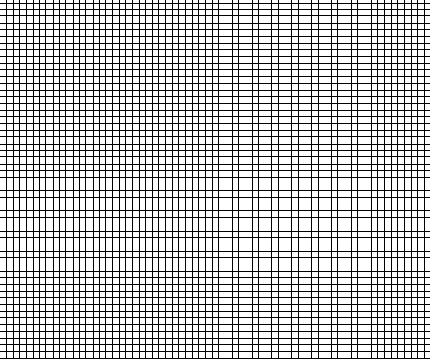
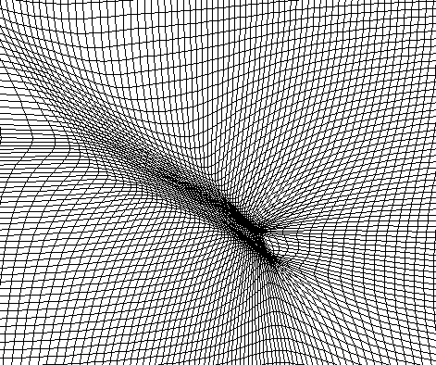
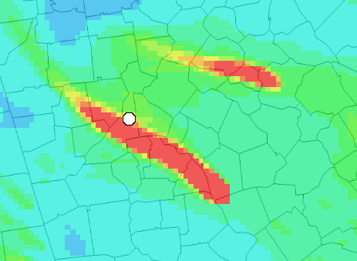
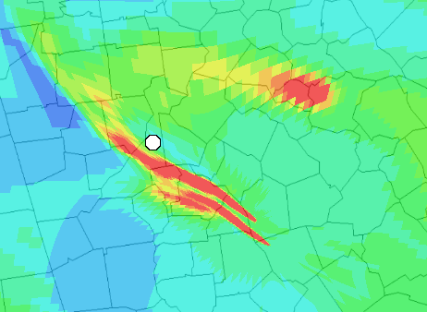
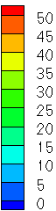
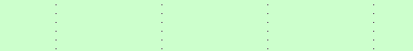
Atmospheric plume modeling with a three-dimensional refinement adaptive grid method
M. Talat Odman, Yongtao Hu; School of Civil and Environmental Engineering, Georgia Institute of Technology
Fernando Garcia-Menendez; Center for Global Change Science, Massachusetts Institute of Technology
Motivation
1. Grid cell weighting
Adaptive grid dispersion test 1
Adaptive grids can be used to enhance the multiscale capabilities of grid-based air quality models. The technique is used to increase solution accuracy by dynamically refining the modeling grid in response to a model variable or parameter. Nearly all prior adaptive grid air quality modeling has been limited to horizontal refinement and vertical adaptation has not yet been explored in operational models. However, full three-dimensional grid adaptation would be valuable in simulations featuring concentrated plumes in the free troposphere, as well as plumes near inversions or the top of the boundary layer. Here a three-dimensional adaptive grid algorithm designed for chemical transport models is presented. The mesh-moving (r-refinement) method allows vertical and horizontal refinement to occur simultaneously yet retains a grid’s original structure, enhancing compatibility with existing air quality models. Advection tests are used to demonstrate the algorithm’s ability to better capture concentration gradients in atmospheric plumes.
  Weights are assigned to each grid cell using a weight function based on model variables or parameters:
a) µg m⁻³
b) Adaptation Weight
  Advection of an instantaneous pollutant puff under WRF-generated wind field:
c) µg m⁻³
d) Adaptation Weight
2D Adaptive Grid in CMAQ
  Adaptive grid modeling can reduce artificial diffusion in CTMs and improve performance:
Fixed Grid (4km)
Adaptive Grid
Side view of the adjusted weight fields (b and d) estimated from (a) blank and (c) single-cell-value concentration fields (µg m⁻³).
2. Grid Movement
Side view of three-dimensional iso-surfaces defined by PM_{2.5} concentration equal to 10 μg m⁻³ in fixed and adaptive grid simulations 1, 5, and 10 hours after release of pollutant puff.
  Refinement is achieved by repositioning grid nodes in response to three-dimensional adaptation weight field:
Unconstrained
adaptation:
Vertically
constrained
adaptation:
PM_{2.5} (µg m⁻³)
Y grid plane intersecting pollutant puff 5 hours after release simulated with unconstrained adaptation and vertically constrained three-dimensional adaptation. Maximum concentrations predicted by fixed and adaptive grid simulations are shown in adjacent plot.
  Three-dimensional adaptation may be fully unconstrained or vertically constrained, maintaining cell area constant throughout each stack of cells:
Adaptive grid dispersion test 2
3-D Adaptive Grid Algorithm
Unconstrained adaptation:
Vertically constrained adaptation:
  Three-dimensional refinement can improve simulations of continuous point sources by retaining higher concentrations along plume centerlines and reducing numerical diffusion:
Fixed Grid
Adaptive Grid
  Key features:
  Dynamic adaptation with simultaneous horizontal and vertical grid refinement
  Total number of nodes and connectivity do not change during the simulation
  A local coordinate transformation into a boundary-conforming curvilinear coordinate system is applied to use the air quality model’s original solution algorithms on adapting grid
  Grid adaptation is achieved applying a 4-step iterative process
Top view of PM_{2.5} concentrations (µg m⁻³) simulated at 2000 m AGL under southeasterly wind field using fixed and adaptive grids
Physical Domain
Computational Domain
Side view of grid response to a normalized weight field using unconstrained adaptation and vertically constrained three-dimensional adaptation
Side view of PM_{2.5} concentrations (µg m⁻³) simulated under uniform vertical wind field using fixed and adaptive grids
z
y
ζ
η
3. Field Redistribution & 4. Grid Convergence
x
ξ
  A high-order accurate and monotonic advection scheme is used as a local interpolator to redistribute the concentration onto the adapted grid:
Recommendations and challenges
3-D adaptation can benefit simulations of concentrated plumes in the free troposphere or near the top of the PBL where vertical grid resolution is typically coarse
Vertically constrained adaptation may simplify implementation into existing models
Global interpolation algorithms highly recommended for 3˗D adaptation
Overall model resolution is still limited by resolution of meteorology and emissions inputs
Contact Information
E
M. Talat Odman
School of Civil and Environmental Engineering
Georgia Institute of Technology
odman@gatech.edu
  Iterative grid adaptation continues until one of the grid convergence criteria is met:
  → either the grid nodes do not move significantly
  → or maximum number of iterations is reached
Pollutant puff shown as a three-dimensional iso-surface bounded by PM_{2.5} concentration equal to 10 µg m⁻³ crossing an intersection of X and Y grid planes. Grid lines and PM_{2.5} concentrations (µg m⁻³) along the planes are also included.
Otherwise to Step 1

